Slide 1
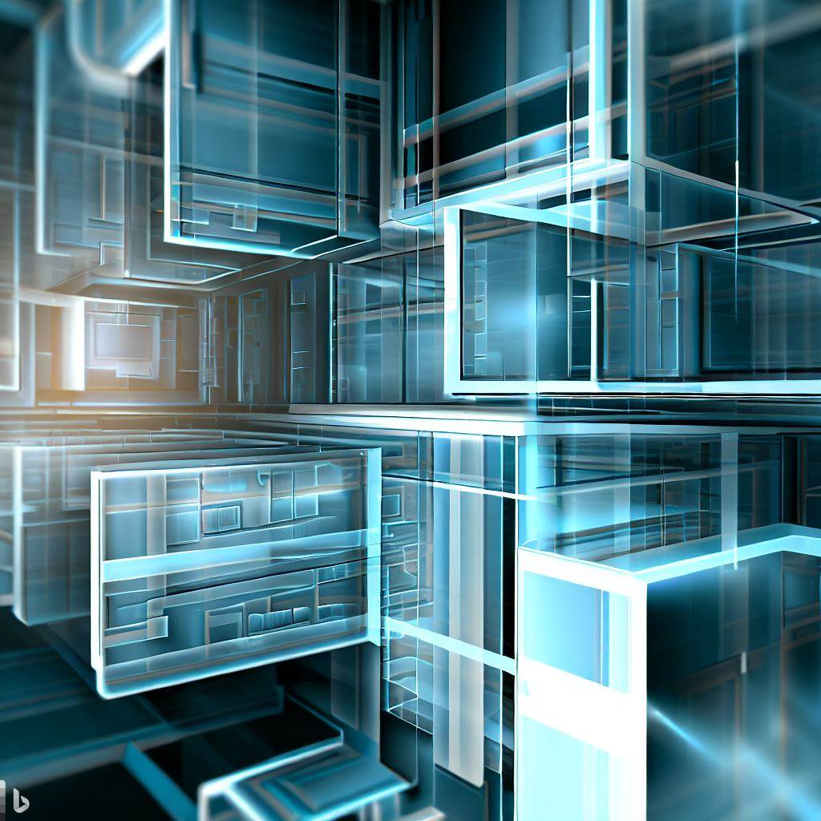
Software Engineering
WEEK 8
ENGR. Muhammad UMER HAROON

Slide 2

WEEK 8

Slide 3
Individual
Contributor
Software
Engineer
Senior
Software
Engineer
Team
Leader
Architect
Increasing responsibility, scope and challenge
Notes:
3

Slide 4
Software Architecture

Slide 5
“Good judgment is usually the result of experience. And experience is frequently the result of bad judgment. But to learn from the experience of others requires those who have the experience to share the knowledge with those who follow.”
-Barry LePatner

Slide 6
Software systems are constructed to satisfy organizations' business goals.
The architecture is a bridge between those (often abstract) business goals and the final (concrete) resulting system.
While the path from abstract goals to concrete systems can be complex, the good news is that software architectures can be designed, analyzed, documented, and implemented using known techniques that will support the achievement of these business and mission goals.

Slide 7
There are many definitions of software architecture , but we will consider this one
The software architecture of a system is the set of structures needed to reason about the system, which comprise software elements, relations among them, and properties of both.

Slide 8
Architecture Is a Set of Software Structures
This is the first and most obvious implication of our definition.
A structure is simply a set of elements held together by a relation. Software systems are composed of many structures, and no single structure holds claim to being the architecture.

Slide 9
Categories of Architectural Structures
There are three categories of architectural structures, which will play an important role in the design, documentation, and analysis of architectures:
Modules
Component-and-connector (C&C) structures.
Allocation structures

Slide 10
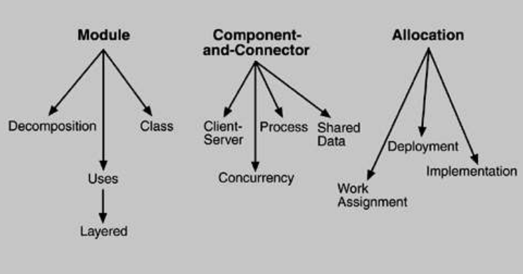

Slide 11
The 3 structures correspond to 3 broad types of decisions that an architectural design involves:
How is the system to be structured as a set of code units?
How is the system to be structured as a set of runtime components and interactions between them?
How is the system to relate to non-software elements in its environment? (CPU, file systems, networks, development teams, etc)

Slide 12
Coding structures views (modules, packages, classes and relationships between them)
Run-time structures or component and connector structures (databases, clients, servers, and connectors indicating communication ways)
Allocation structures (deployment and work break down structures)

Slide 13

Details
1. First, some structures partition systems into implementation units, we call modules. Modules are assigned specific computational responsibilities, and are the basis of work assignments for progratning teams (Team A works on the database, Team B works on the business rules, Team C works on the user interface, etc.). In large projects, these elements (modules) are subdivided for assignment to subteams. For example, the database for a large enterprise resource planning (ERP) implementation might be so complex that its implementation is split into many parts. The structure that captures that decomposition is a kind of module structure, the module decomposition structure in fact. Another kind of module structure emerges as an output of object-oriented analysis and design class diagrams. If you aggregate your modules into layers, you've created another (and very useful) module structure. Module structures are static structures, in that they focus on the way the system's functionality is divided up and assigned to implementation teams.

Slide 14
2. Other structures are dynamic, meaning that they focus on the way the elements interact with each other at runtime to carry out the system's functions. Suppose the system is to be built as a set of services. The services, the infrastructure they interact with, and the synchronization and interaction relations among them form another kind of structure often used to describe a system. These services are made up of (compiled from) the programs in the various implementation units that we just described. Here we will call runtime structures component-and-connector (C&C) structures. The term component is overloaded in software engineering. In our use, a component is always a runtime entity.

Slide 15
3. A third kind of structure describes the mapping from software stuctures to the system's organizational, developmental, installation, and execution environments. For example, modules are assigned to teams to develop, and assigned to places in a file structure for implementation, integration, and testing. Components are deployed onto hardware in order to execute. These mappings are called allocation structures.

Slide 16
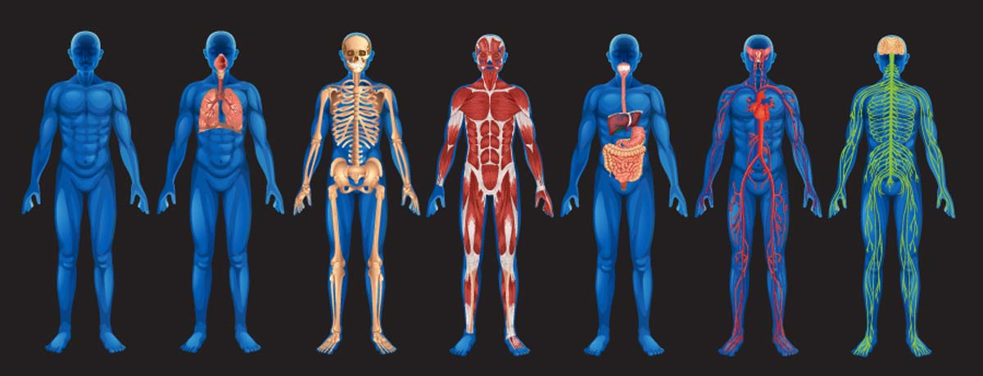
Architectural Structures and Views
The neurologist, the orthopedist, the hematologist, and the dermatologist all have different views of the structure of a human body .

Slide 17
So is the case with software. Modern systems are fequently too complex to grasp all at once. Instead, we restrict our attention at any one moment to one (or a small number) ofthe software system's structures.
To communicate meaningfully about an architecture, we must make clear which structure or structures we are discussing at the moment which view we are taking of the architecture

Slide 18
Structures and Views
We will be using the related terms structure and view when discussing architecture representation.
• A view is a representation of a coherent set of architectural elements, as written by and read by system stakeholders. It consists of a representation of a set of elements and the relations among them.
• A structure is the set of elements itself, as they exist in software or hardware.

Slide 19
In short, a view is a representation of a structure. For example, a module structure is the set of the system's modules and their organization. A module view is the representation of that structure, documented according to a template in a chosen notation, and used by some system stakeholders.
So: Architects design structures. They document views of those structures.

Slide 20
Different stakeholders – different prospective
Architecture also means different things to different stakeholders.
For example,
• a Network Engineer would only be interested in the hardware and network configuration of the system;
• a Project Manager in the key components to be developed and their timelines;
• a Developer in classes that make up a component; and
• a Tester in testable scenarios.

Slide 21
Solution
Solution came from “4+1” view model
• The views are used to describe the system from the viewpoint of different stakeholders, such as end-users, developers and project managers.
• Suitable for large and challenging architectures
• Describe different aspects of the system into different views.

Slide 22
(Why?) Because different stakeholders have different aspects
• DEVELOPERS – Aspects of Systems like classes
• SYSTEM ADMINISTRATOR – Deployment, hardware and network configuration
• TESTER , PM, CUSTOMER -- ??? • “4+1” view model provides a “better organization with better separation of concern”.

Slide 23
For each view, the architects can pick a certain architectural style
Use case view - Encompass the use cases that describe the behavior of the system as seen by its end users, analysts, and testers
Logical view - Encompass the classes, interfaces, and collaborations that form the vocabulary of the problem and its solution
Process view - Encompass the processes that form the system's concurrency and synchronization mechanisms
Development view - Encompass the components and files that are used to assemble and release the physical system
Physical view - Encompass the nodes that form the system's hardware topology on which the system executes
Notes:
The logical view focuses on functionality exposed to end users. The development view shows how the system is structured, with an emphasis on the concerns of developers and testers. The process views show the dynamic aspect of the system and how it behaves during execution. The physical view shows how a system is laid out or distributed and how components connect to each other. The "+1" refers to scenarios, which show use cases of the system and provide a context to understand the other four views.

Slide 24
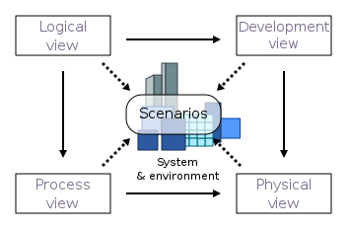

Slide 25
Logical View: The logical view is concerned with the system’s functionality as it pertains to end-users.
Class diagrams and state diagrams are examples of UML diagrams that are used to depict the logical view.

Slide 26
Process View: The process view focuses on the system’s run-time behavior and deals with the system’s dynamic elements. It explains the system processes and how they communicate. Concurrency, distribution, integrator, performance, and scalability are all addressed in the process view. The sequence diagram, communication diagram, and activity diagram are all UML diagrams that can be used to describe a process view.
Notes:
Concurrency refers to the ability of a system to handle multiple tasks or requests at the same time, in parallel. Concurrency can improve system performance and responsiveness, but it can also introduce synchronization issues, such as race conditions or deadlocks, if not properly managed.
Distribution refers to the ability of a system to operate across multiple physical or logical locations, such as different servers or data centers. Distributed systems can provide benefits such as improved fault tolerance, scalability, and availability, but they also require careful design and management to ensure consistency and reliability.
Integrator, or integration, refers to the ability of a system to connect and communicate with other systems, services, or data sources, often through APIs or other interfaces. Integrator concerns include compatibility, data consistency, security, and performance, and require careful design and testing to ensure smooth and reliable integration.

Slide 27
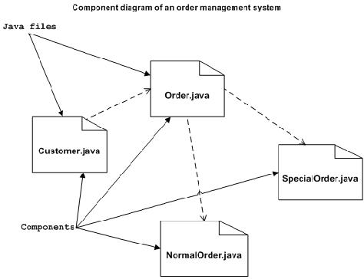
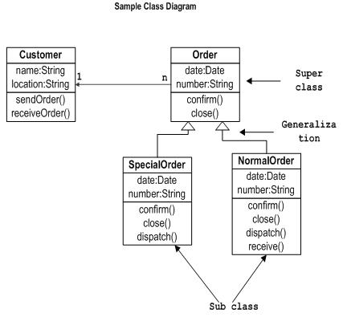
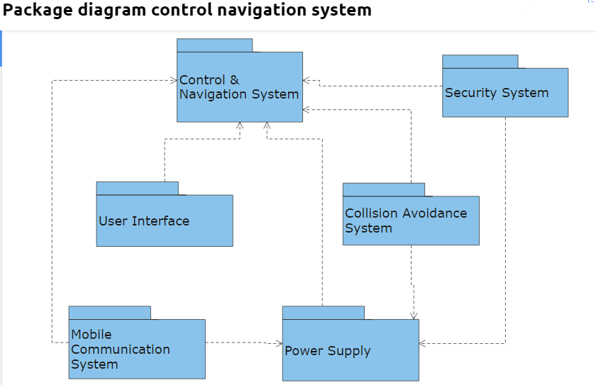
Development View: The development view depicts a system from the standpoint of a programmer and is concerned with software administration. The implementation view is another name for this view. It describes system components using the UML Component diagram. The Package diagram is one of the UML diagrams used to depict the development view.
Notes:
A component diagram is similar to a class diagram in that it illustrates how items in a given system relate to each other, but component diagrams show more complex and varied connections that most class diagrams can.
A component is generally bigger and more abstract than a class. While a class is a relatively low-level blueprint(design) for an object instance, a component might be a set of classes which together forms an encapsulated module(implementation) you then interface with. A component might even contain no classes at all!
Now, component diagrams don't show the actual code but the dependencies between the actual implemented software components (these components can be anything like executables,files,folders etc

Slide 28
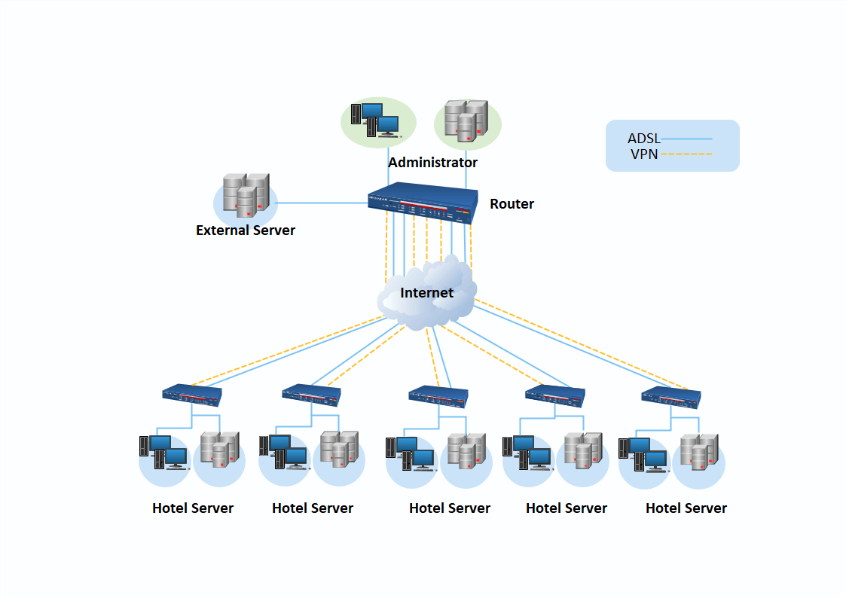
Physical View: The physical view portrays the system from the perspective of a system engineer. The physical layer, it is concerned with the topology of software components as well as the physical connections between these components. The deployment view is another name for this view. The deployment diagram is one of the UML diagrams used to depict the physical perspective.

Slide 29
Scenarios: A small number of use cases, or scenarios, that become the fifth view, are used to illustrate the description of architecture. Sequences of interactions between objects and processes are described in the scenarios. They are used to identify architectural aspects as well as to demonstrate and assess the design of the architecture. They can also be used as a starting point for architecture prototype testing. The use case view is another name for this view.

Slide 31
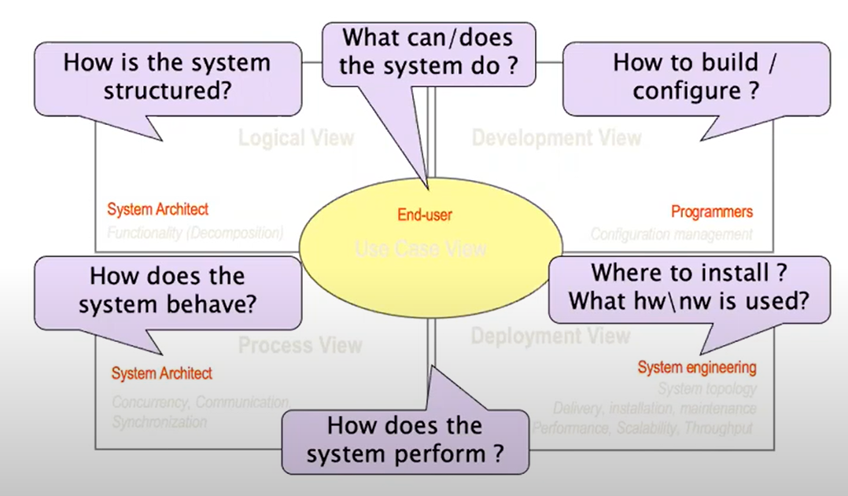

Slide 32
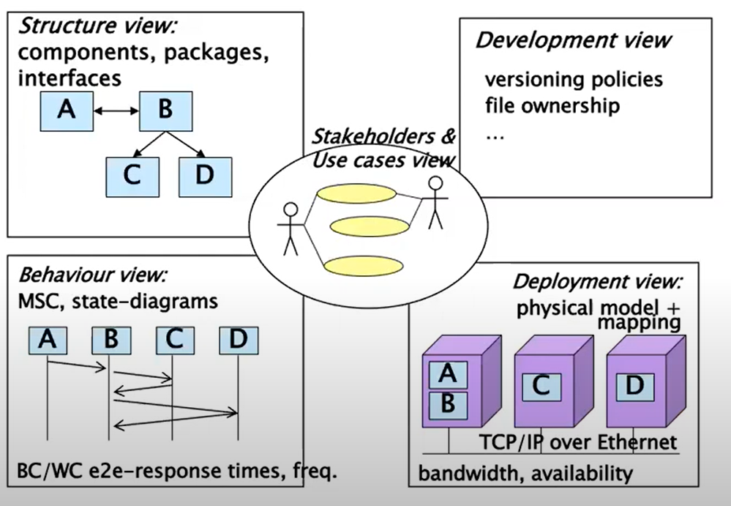

Slide 34

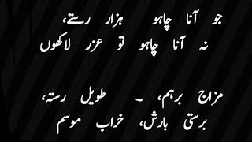
Eight Week Summary
Here is what we learned

Slide 35

Thank You!

